Slide 1
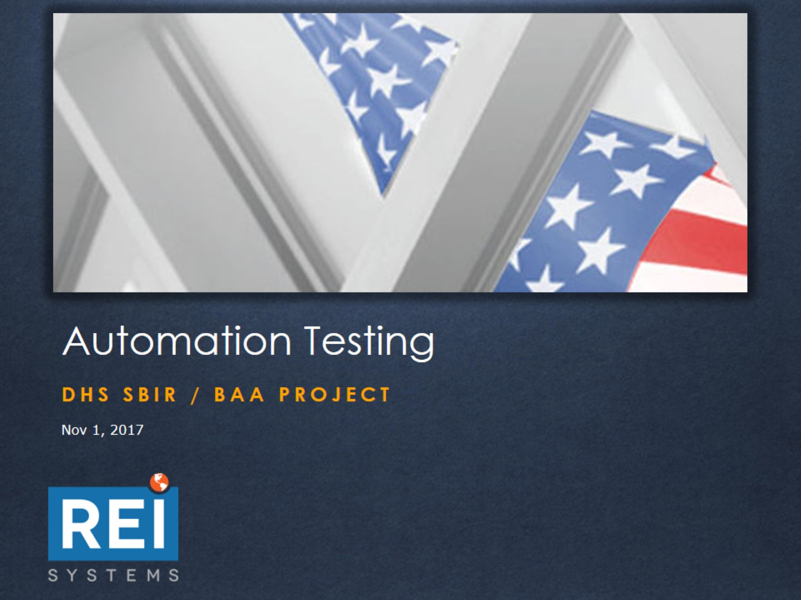
Automation Testing

Slide 2
Automation Testing

Slide 3
Automation Testing

Slide 4
Automation Testing

Slide 5
Automation Testing

Slide 6
Automation Testing

Slide 7
Automation Testing

Slide 8
Automation Testing

Slide 9
Automation Testing

Slide 10
Automation Testing

Slide 11
Automation Testing

Slide 12
Automation Testing

Slide 13
Automation Testing

Slide 14
Automation Testing

